Slide 1
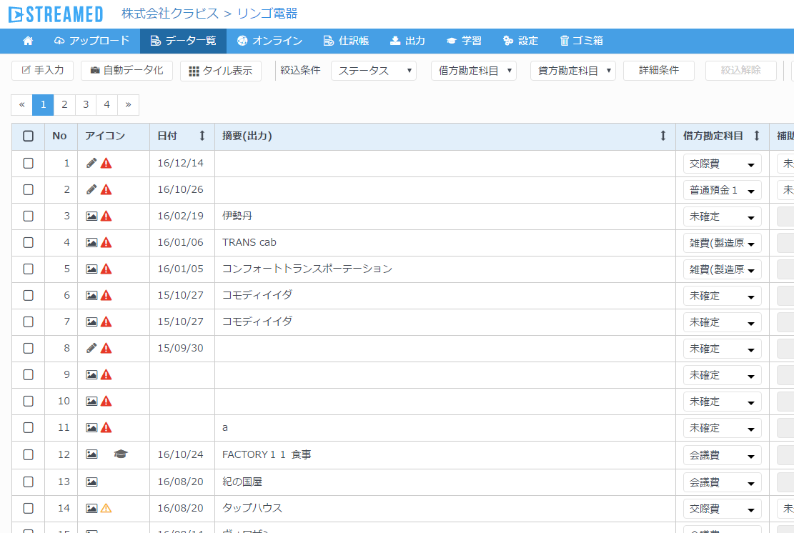
Change the paging number order asc to desc on all list view.
AS-IS
TO-BE
In this case, Oldest data are displayed in page1 and
lastest data are displayed on page4.

